Slide 1
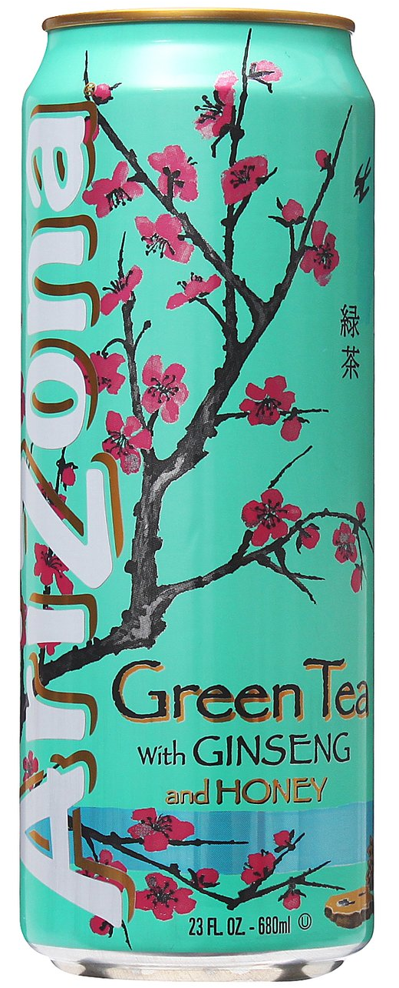

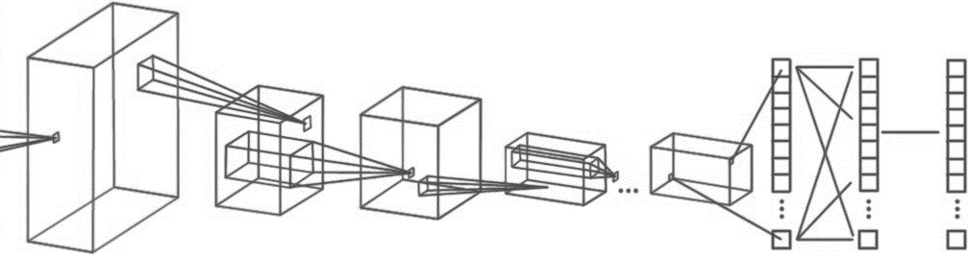
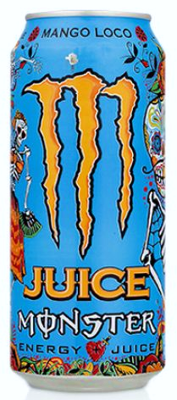
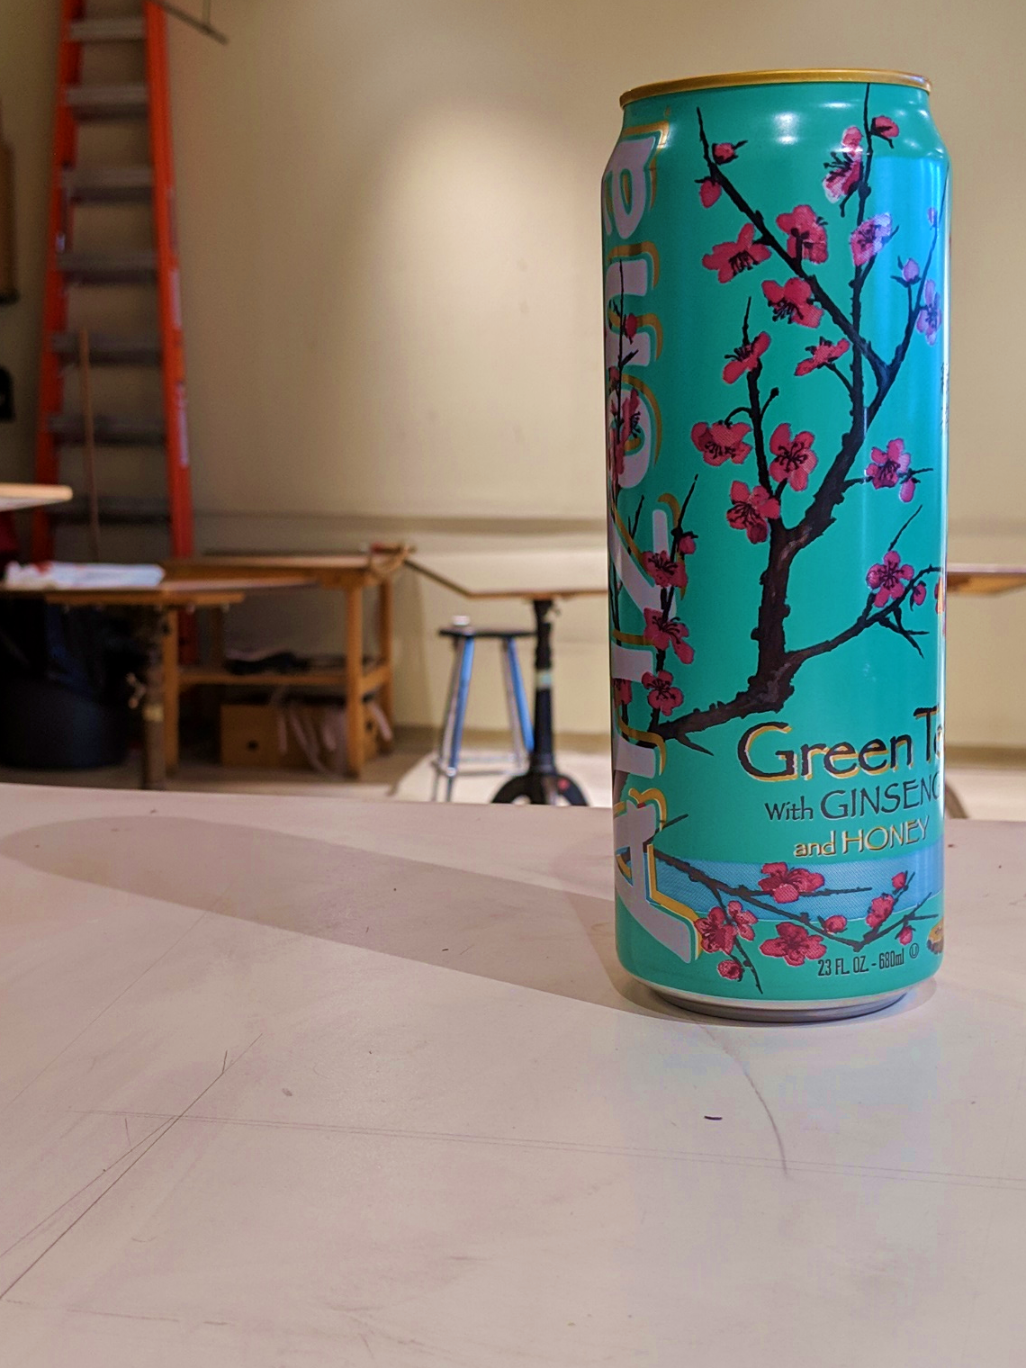
Computer Engineering 186
Spring 2019
Department of Electrical and Computer Engineering
Alexis J. Renderos, William Lavelle, Rolf Anderson, Ritvik Maripally
Adaptive Visual Target Identification and Tracking through
Convolutional Neural Network (CNN) based Machine Learning and Computer Vision
Abstract
The aim of this project is to identify a chosen object of interest at range using a camera feed and an image processing algorithm to assist in the detection, identification and tracking of the target.
Image Processing
The aim of this project is to identify a chosen object of interest at range using a camera feed and an image processing algorithm to assist in the detection, identification and tracking of the target. It is expected that the object of interest has already been analyzed prior to identification attempts, and that the target is in the field of view of the camera.
Image Processing
The aim of this project is to identify a chosen object of interest at range using a camera feed and an image processing algorithm to assist in the detection, identification and tracking of the target. It is expected that the object of interest has already been analyzed prior to identification attempts, and that the target is in the field of view of the camera.
Data Collection and Analysis
To properly analyze incoming image data, we must first determine the characteristics of our target. The three chosen targets (Fig. 1) were photographed over 1,000 times each in varying lighting conditions and at varying angles and varying degrees of occlusion. This provided us with a set of testing data and training data for our machine learning algorithm. We also analyzed the colors and markings of the targets, the angle of the can relative to the camera and the lighting conditions. This was later used to create an object recognition and tracking algorithm.
Target Identification
The aim of this project is to identify a chosen object of interest at range using a camera feed and an image processing algorithm to assist in the detection, identification and tracking of the target. It is expected that the object of interest has already been analyzed prior to identification attempts, and that the target is in the field of view of the camera.
Conclusion and Analysis
Overall, the CNN based algorithm performed equally in comparison to the purely algorithmic solution. We found that the CNN algorithm had no trouble with identification but struggled heavily when faced with target occlusion. In contrast, the algorithmic solution excelled at recovering from occlusion, but struggled with target identification in extreme light conditions. We believe that with enough training data and training time/epochs that the CNN algorithm will overtake the success of the algorithmic solution.
INPUT
CONVOLUTION + RELU POOLING
CONVOLUTION + RELU POOLING …
FLATTEN
FULLY
CONNECTED
SOFTMAX
FEATURE LEARNING
CLASSIFICATION
Acknowledgements

